Slide 1
Transmit Focusing and PSF

Slide 2
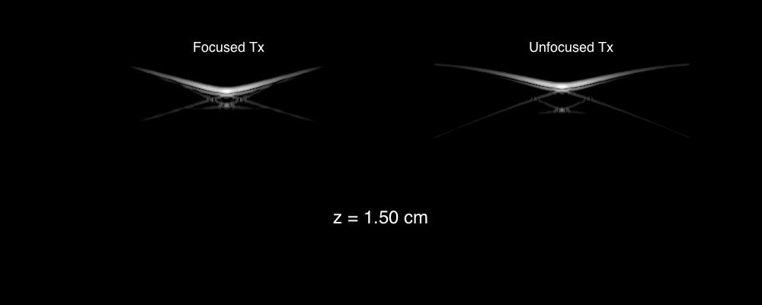
Propagating PSF

Slide 3
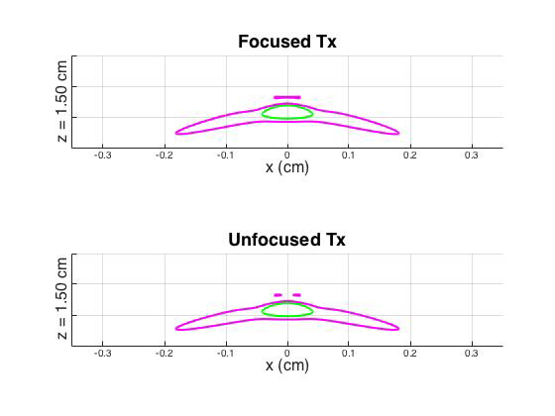
6 dB and 12 dB Contours

Slide 4
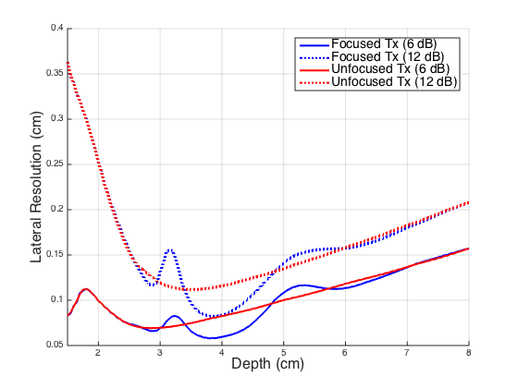
Lateral Resolution vs Depth

